Slide 1
The Supervised Learning Workshop Chapters 3 and 4
LY Catherine u21806799
QIU Lucie u32111200
QIU Loic u32109662
HOU Jiayan u32100601
WENG Christelle u32111006
WANG Louise u32109664

Slide 2
Introduction
Definitions :
Linear regression is a method used to find the straight line that best fits a set of
data points representing the relationship between two continuous variables. It is used to make predictions or understand how one variable affects another.
Autoregression is a method used to predict future values of a variable based on
its past values. It involves using a linear regression model to identify trends in
time series data and predict future values of the variable.
What is the use of linear regression & autoregression :
Linear regression is used in various fields while autoregression is commonly used in finance, economics, and weather forecasting.

Slide 3
Use case presentation and problem definition
For the linear regression models, we aim to predict or model continuous values, from recorded air temperatures from the years 1841 to 2010.
For the auto-regression models, we aim to predict the closing price of the S&P 500 over the years 1986 to 2018 and a year into the future.
Does a simple linear regression allow us to approximate the evolution of temperatures over a period? And in which case can we use an autoregression models?

Slide 4
Data Analytics approach definition and explanation
Chapter 3 Linear regression
3.01 : Plotting data with a moving average
3.02 : Linear model using the least square methods
3.03 : Dummy variables
3.04 : Polynomial models with linear regression
3.05 : Linear regression with gradient descent
Chapter 4 Auto- regression
4.01 Auto-regression models

Slide 5
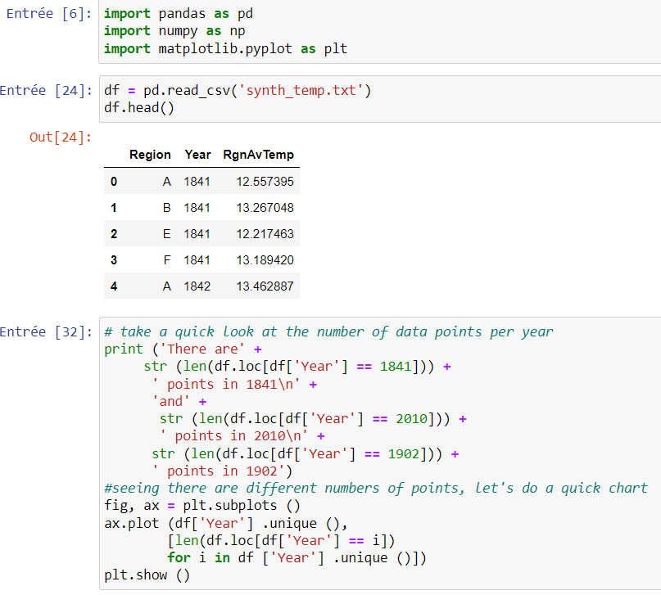
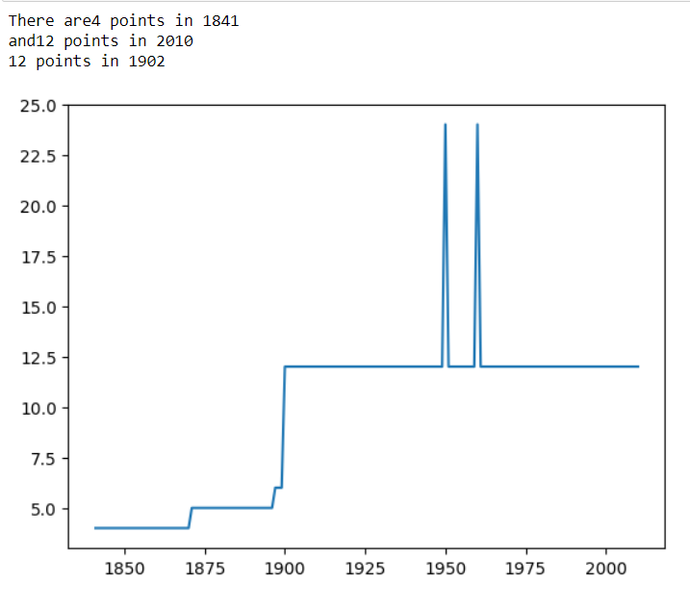
Chapter 3 – exercise 3.01 Catherine

Slide 6
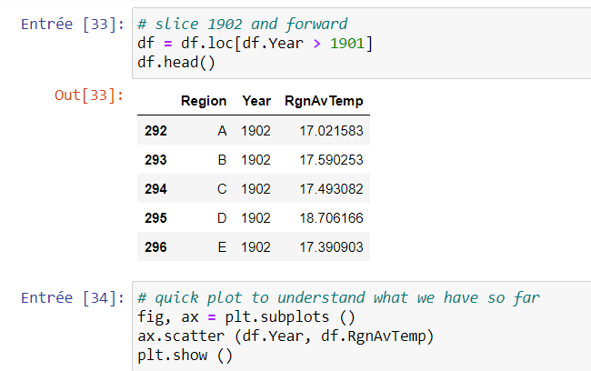
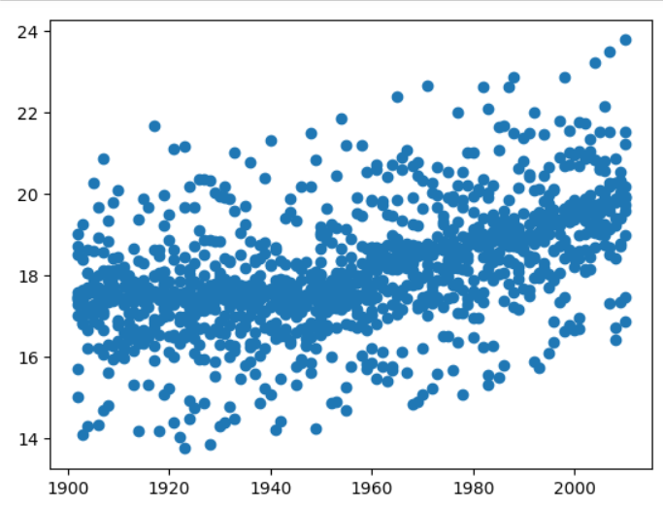
Chapter 3 – exercise 3.01 Catherine

Slide 7
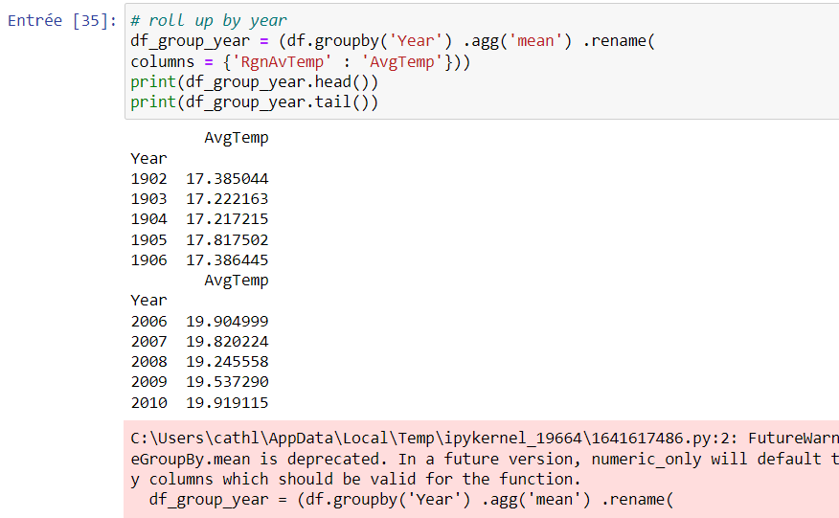
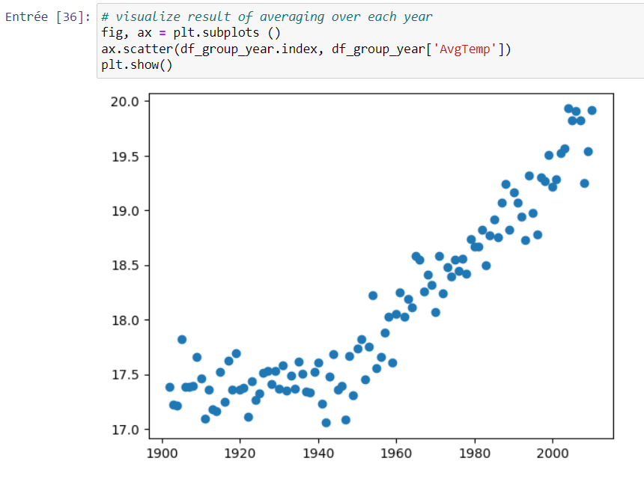
Chapter 3 – exercise 3.01 Catherine

Slide 8
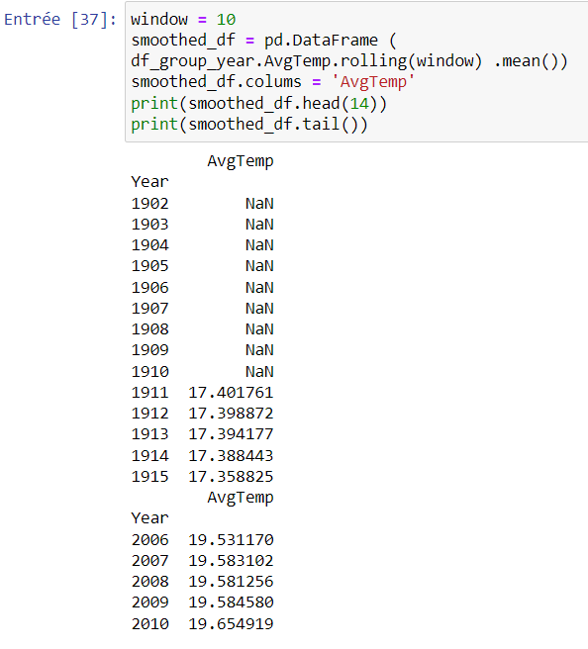
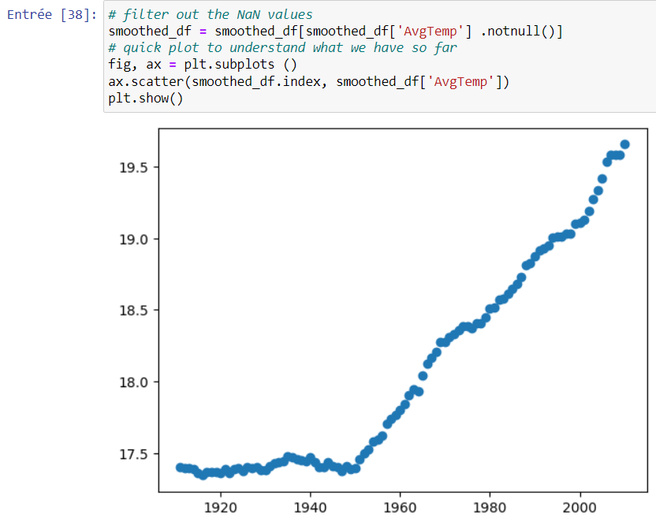
Chapter 3 – exercise 3.01 Catherine

Slide 9
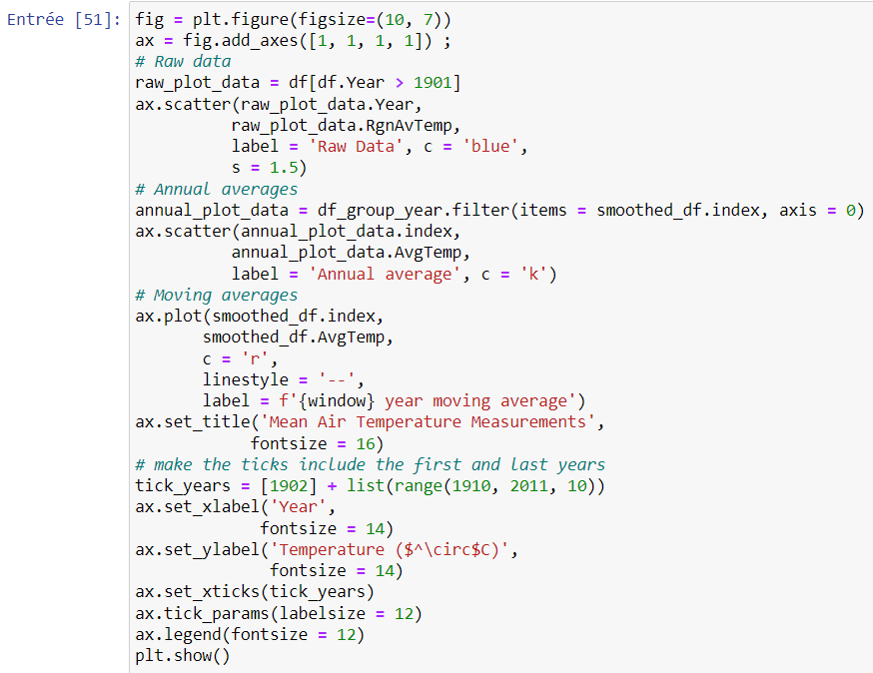
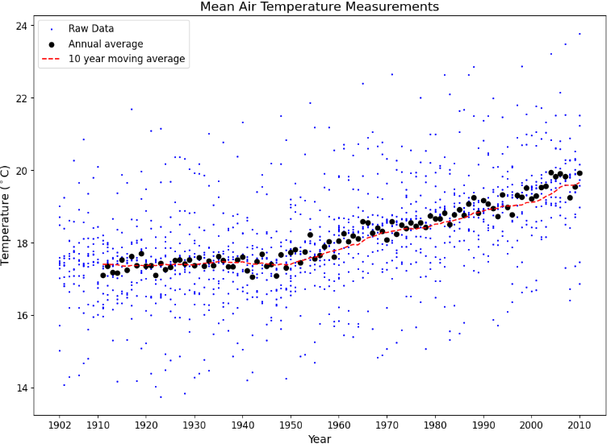
Chapter 3 – exercise 3.01 Catherine

Slide 10
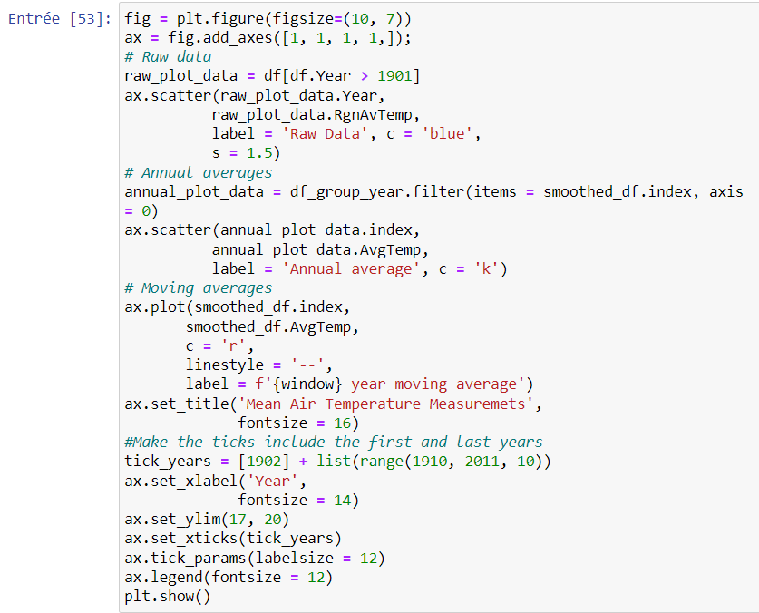
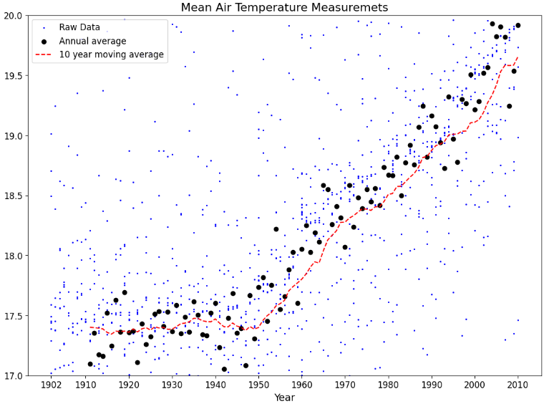
Chapter 3 – exercise 3.01 Catherine

Slide 11
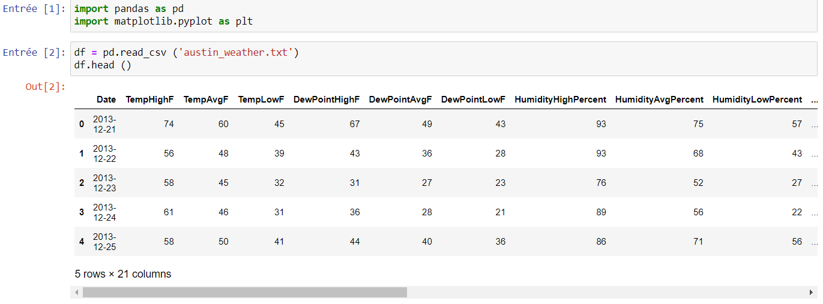
Chapter 3 – activity3.01 Catherine

Slide 12
Conclusion of exercise 3.01
Thanks to the first exercise of the chapter 3, we learnt how to upload dataset, how to use different functions such as plt.show(); print (); how to read a dataset.

Slide 13
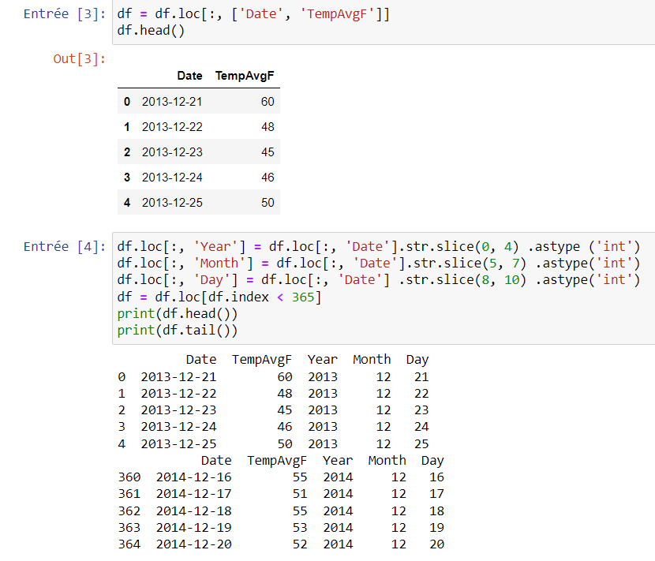
Chapter 3 – activity3.01 Catherine

Slide 14
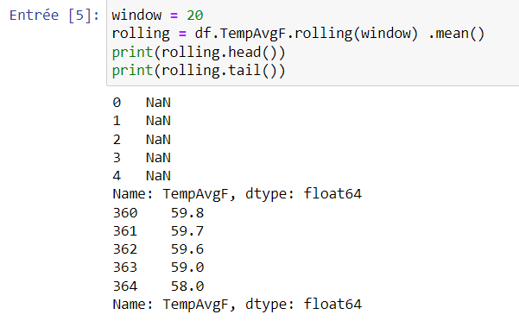
Chapter 3 – activity3.01 Catherine

Slide 15
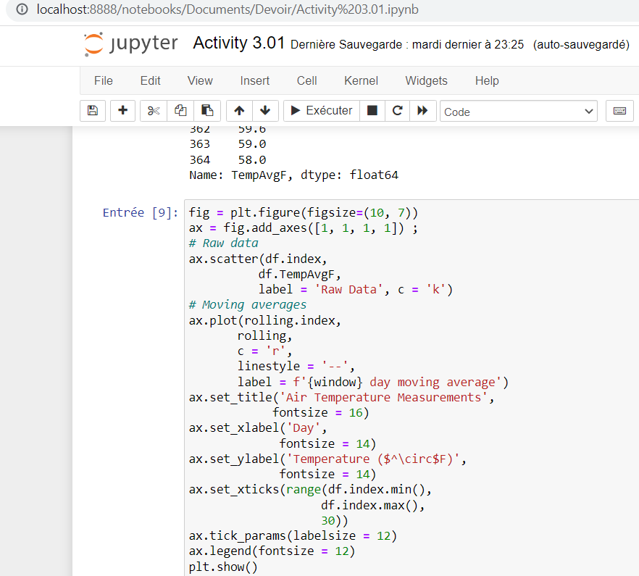
Chapter 3 – activity3.01 Catherine

Slide 16
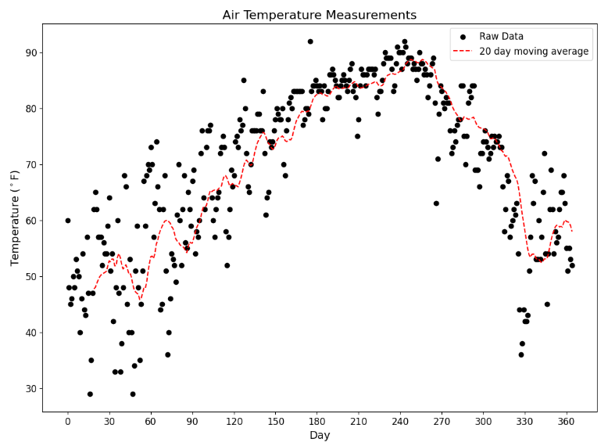
Chapter 3 – activity3.01 Catherine

Slide 17
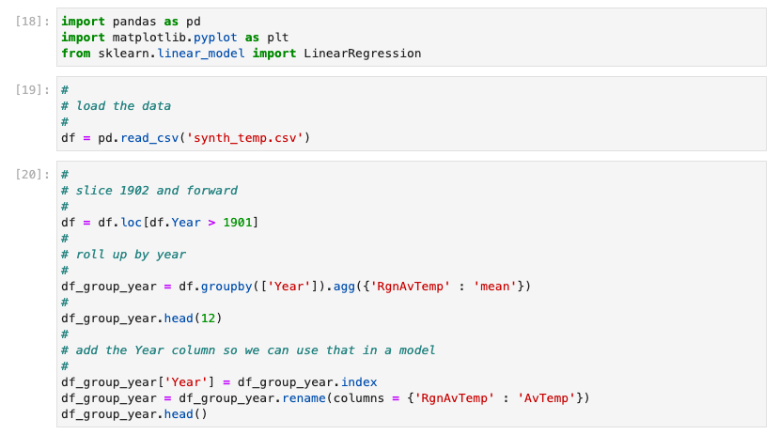
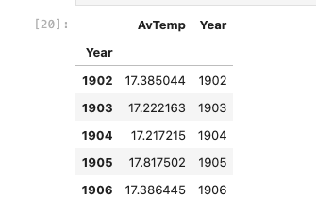
Chapter 3 – exercise 3.02 Christelle

Slide 18
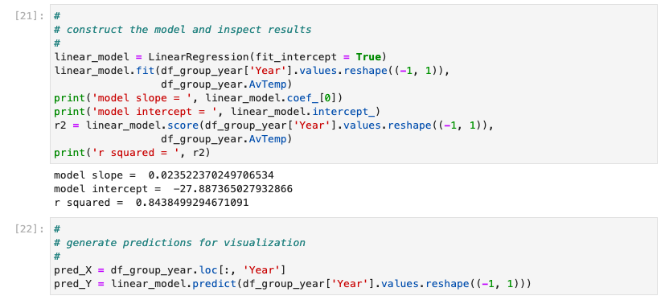
Chapter 3 – exercise 3.02 Christelle

Slide 19
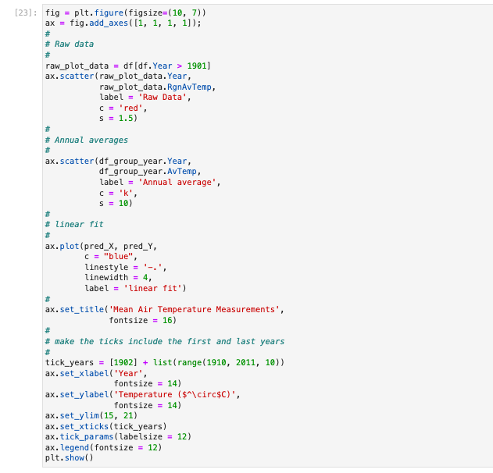
Chapter 3 – exercise 3.02 Christelle
This code is to create a scatter plot with a linear regression line and set various properties of the graph such as :
the title, ax.set
the axis labels, ax.set_xlabel
the tick marks : ax.tick.param
the legend : ax.legend

Slide 20
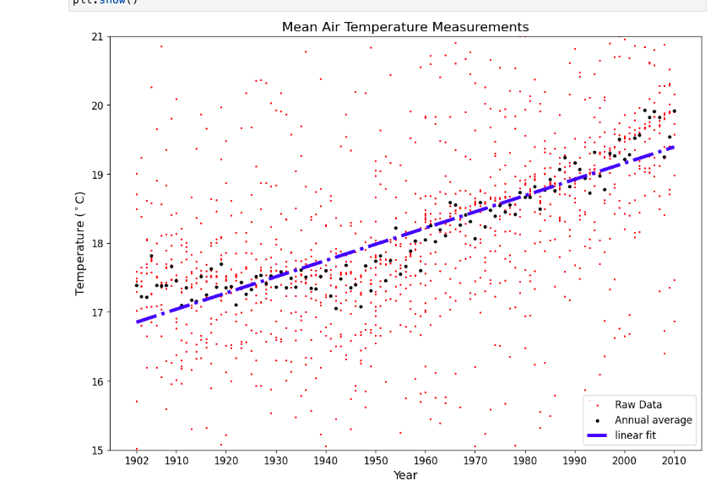
Chapter 3 – exercise 3.02 Christelle
In this graph :
raw data points are too scattered
the annual averages are fairly spread
don't seem to follow a perfectly straight line
So this method/ model is not suitable for our data.

Slide 21
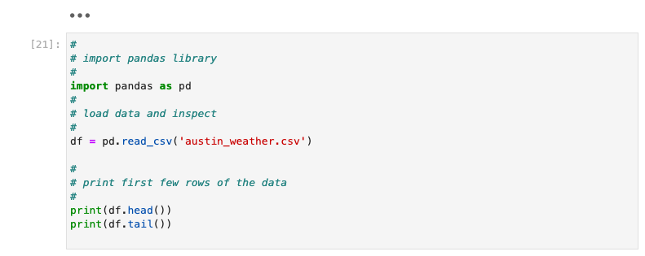
Chapter 3 – Activity 3.02 Christelle

Slide 22
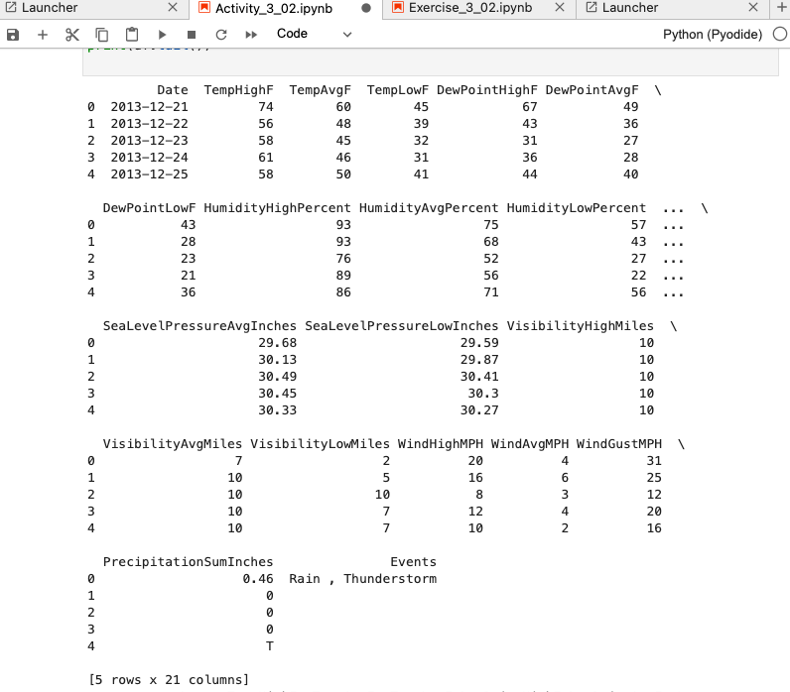
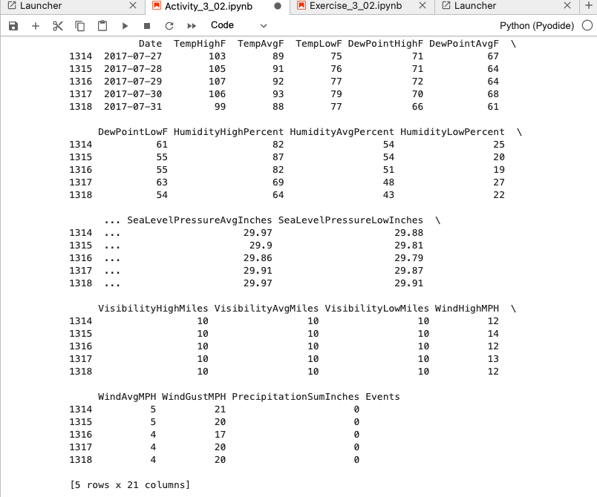
Chapter 3 – Activity 3.02 Christelle
The head() method : the first 5 rows of the data
the tail() method : the last 5 rows of the data

Slide 23
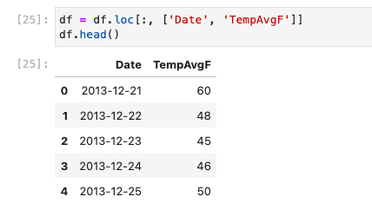
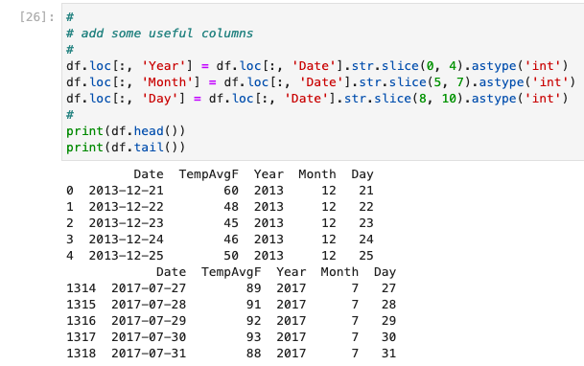
Chapter 3 – Activity 3.02 Christelle

Slide 24
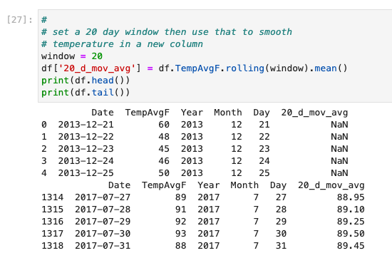
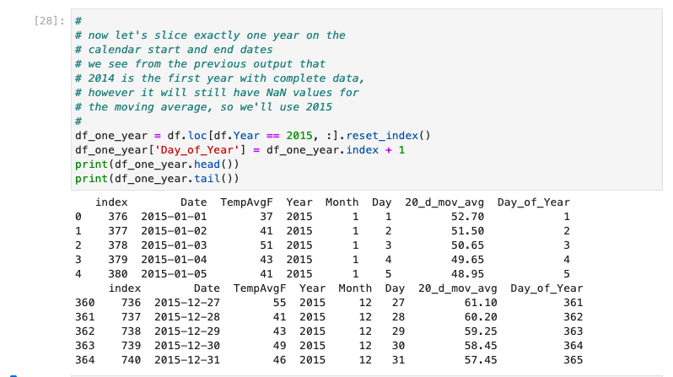
Chapter 3 – Activity 3.02 Christelle

Slide 25
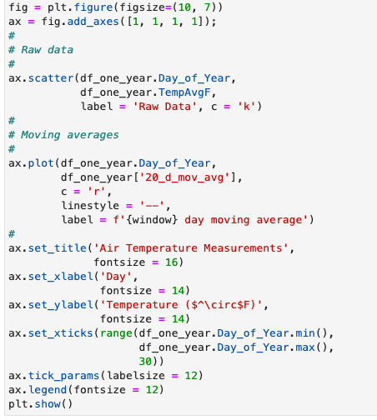
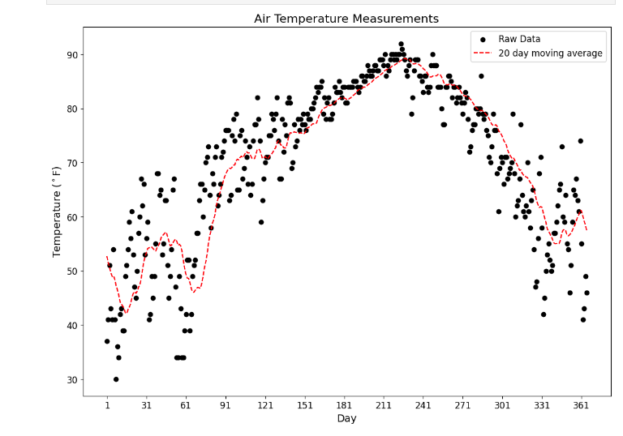
Chapter 3 – Activity 3.02 Christelle

Slide 26
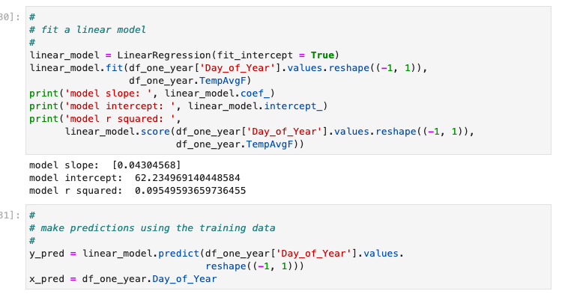
Chapter 3 – Activity 3.02 Christelle

Slide 27
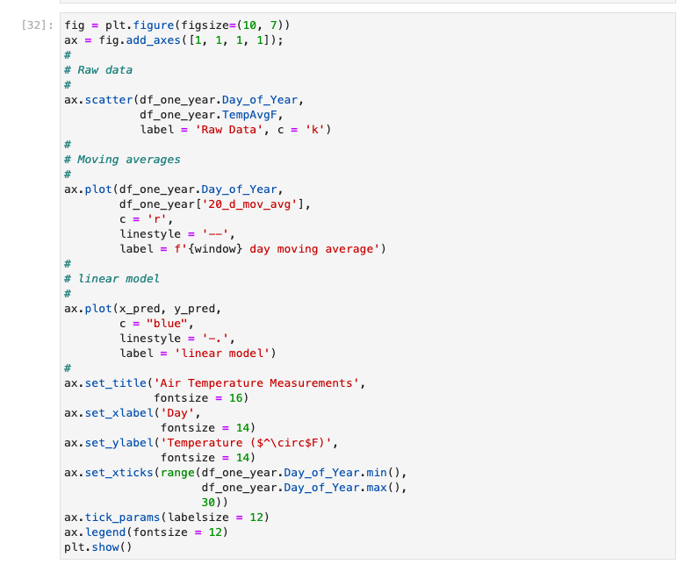
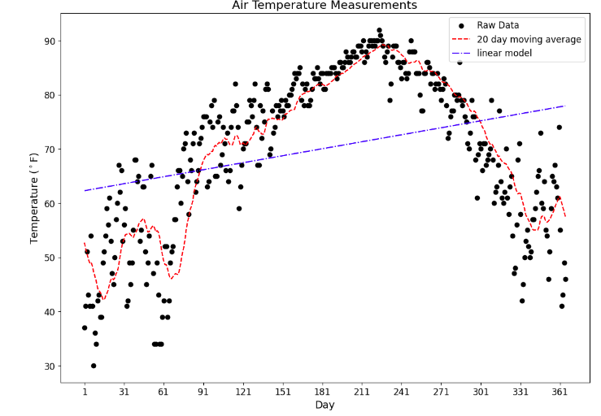
Chapter 3 – Activity 3.02 Christelle

Slide 28
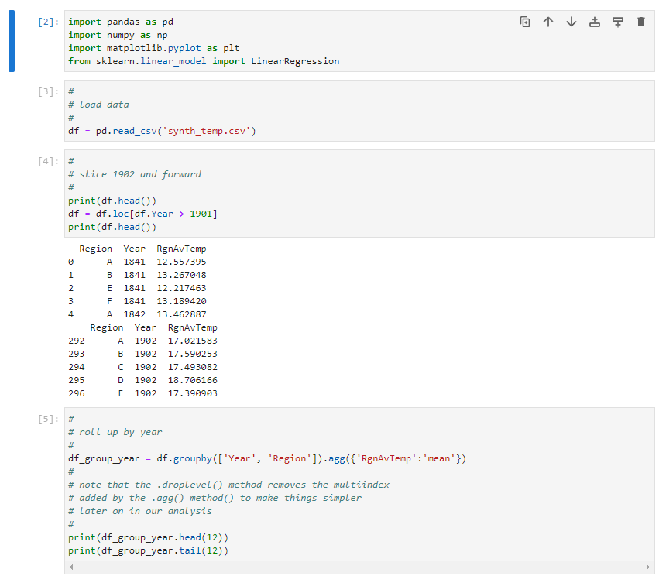
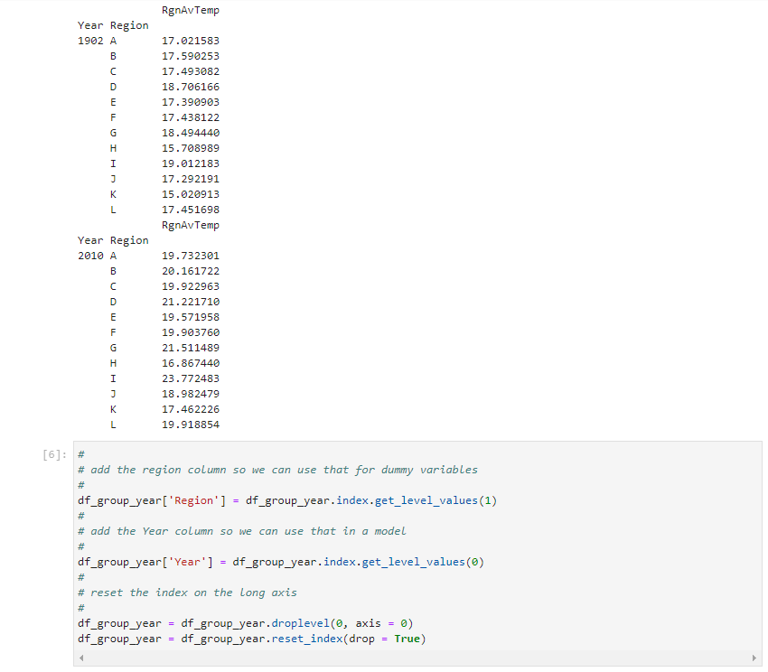
Chapter 3 – exercise 3.03 Loic

Slide 29
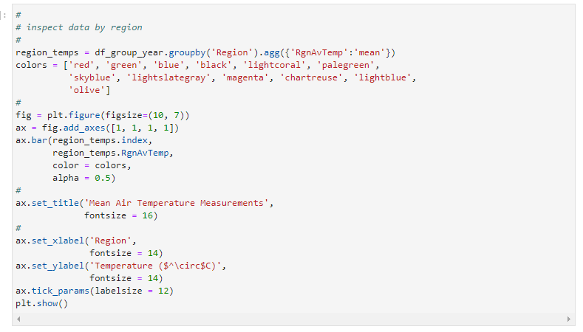
Chapter 3 – exercise 3.03 Loic

Slide 30
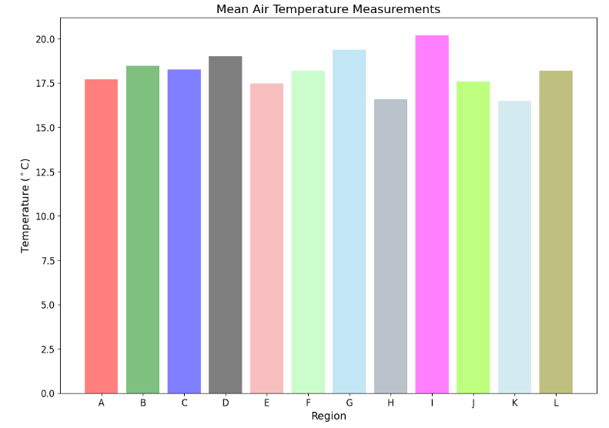
Chapter 3 – exercise 3.03 Loic

Slide 31
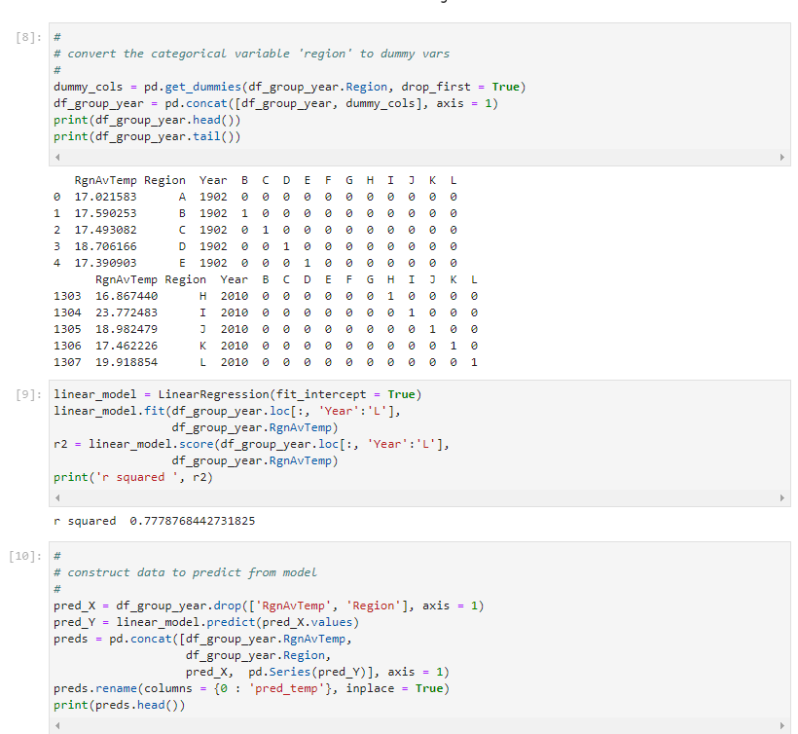
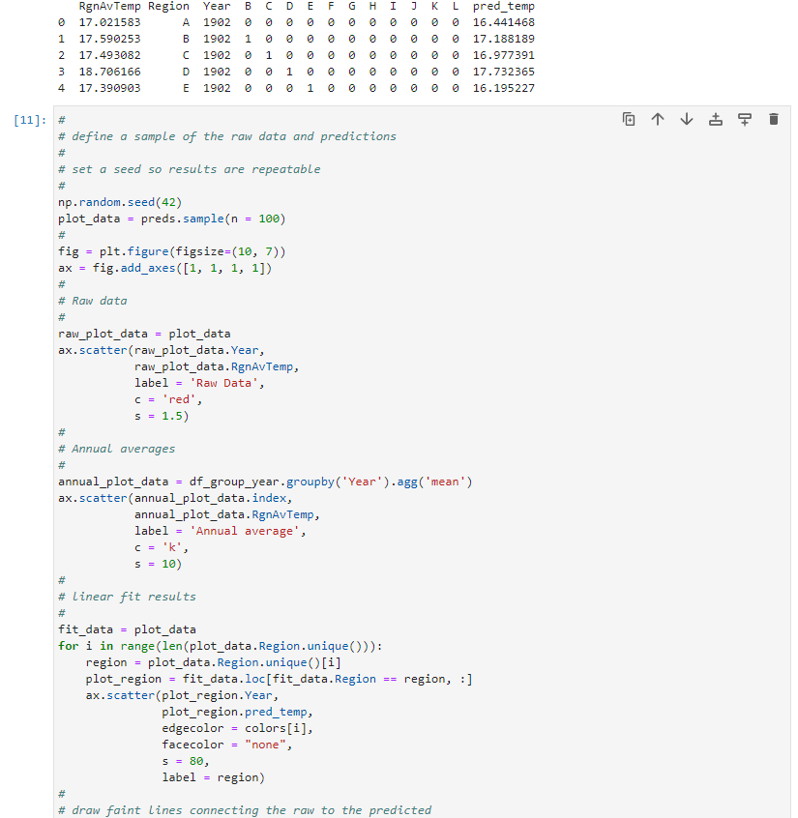
Chapter 3 – exercise 3.03 Loic

Slide 32
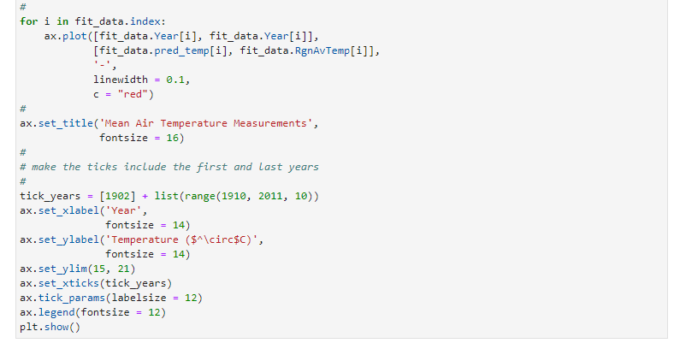
Chapter 3 – exercise 3.03 Loic

Slide 33
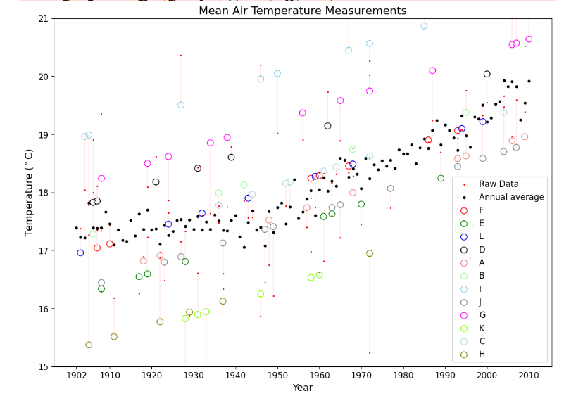
Chapter 3 – exercise 3.03 Loic

Slide 34
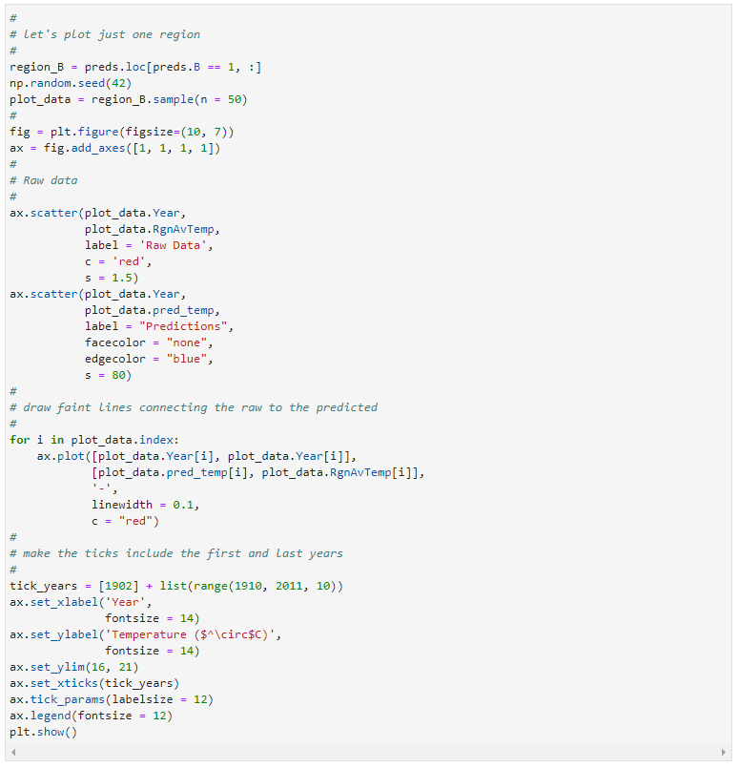
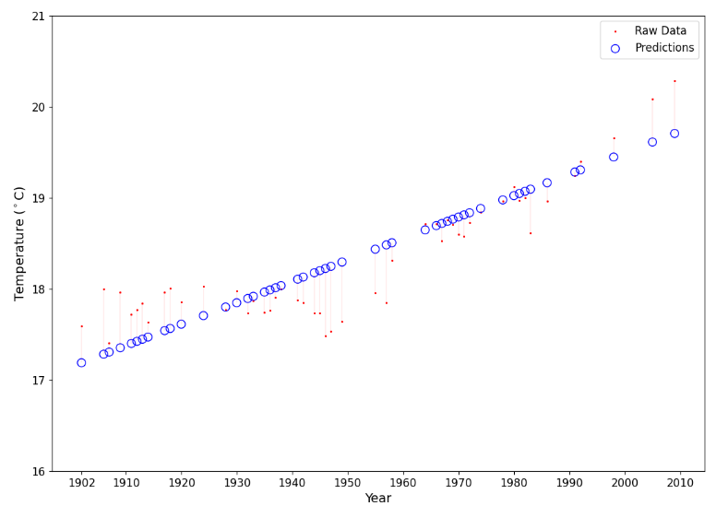
Chapter 3 – exercise 3.03 Loic

Slide 35
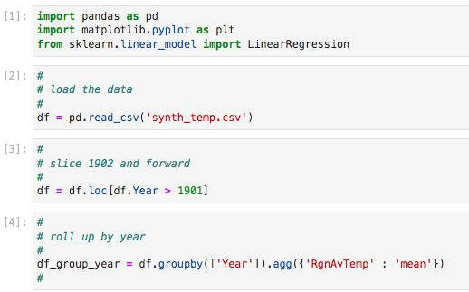
Chapter 3 – exercise 3.04 Jiayan

Slide 36
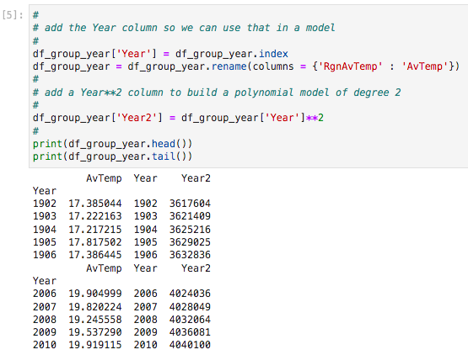
Chapter 3 – exercise 3.04 Jiayan

Slide 37
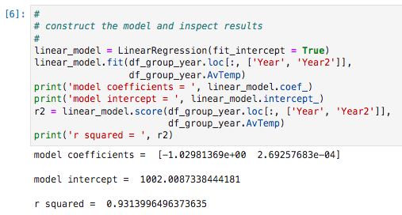
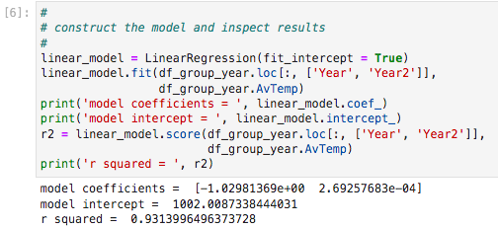
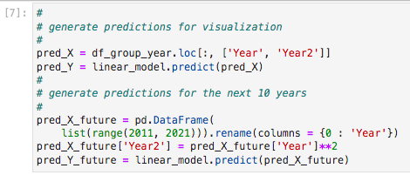
Chapter 3 – exercise 3.04 Jiayan
After PLAY
Before PLAY

Slide 38
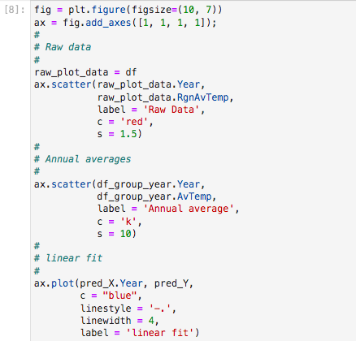

Chapter 3 – exercise 3.04 Jiayan

Slide 39

Chapter 3 – exercise 3.04 Jiayan

Slide 40

Chapter 3 – exercise 3.05 Lucie

Slide 41


Chapter 3 – exercise 3.05 Lucie

Slide 42


Chapter 3 – exercise 3.05 Lucie

Slide 43


Chapter 3 – exercise 3.05 Lucie

Slide 44


Chapter 3 – exercise 3.05 Lucie

Slide 45

Chapter 3 – exercise 3.05 Lucie

Slide 46


Chapter 4 – exercise 4.01 Louise

Slide 47


Chapter 4 – exercise 4.01 Louise

Slide 48


Chapter 4 – exercise 4.01 Louise

Slide 49


Chapter 4 – exercise 4.01 Louise

Slide 50



Chapter 4 – exercise 4.01 Louise

Slide 51



Chapter 4 – exercise 4.01 Louise

Slide 52


Chapter 4 – exercise 4.01 Louise

Slide 53


Chapter 4 – exercise 4.01 Louise

Slide 54




Chapter 4 – exercise 4.01 Louise

Slide 55
Conclusion
To conclude, both linear regression and autoregression are valuable tools for analyzing data and making predictions. However, they are suited for different types of data and applications.
Linear regression is useful when examining the relationship between two variables, while autoregression is ideal for analyzing time-series data.

